Slide 1
Crimes in India (CSE 308)
Data Analysis

Slide 2
Objectives
Crimes committed against ST
Crimes committed against Woman
Juvenile Crimes
Crimes committed against SC
Crimes committed against Children

Slide 3
Objective – 1 Crimes committed against Scheduled Tribes
Goals:
Density Graph over the Years
Top Crimes committed against ST
Top States where there is high crime rate

Slide 4
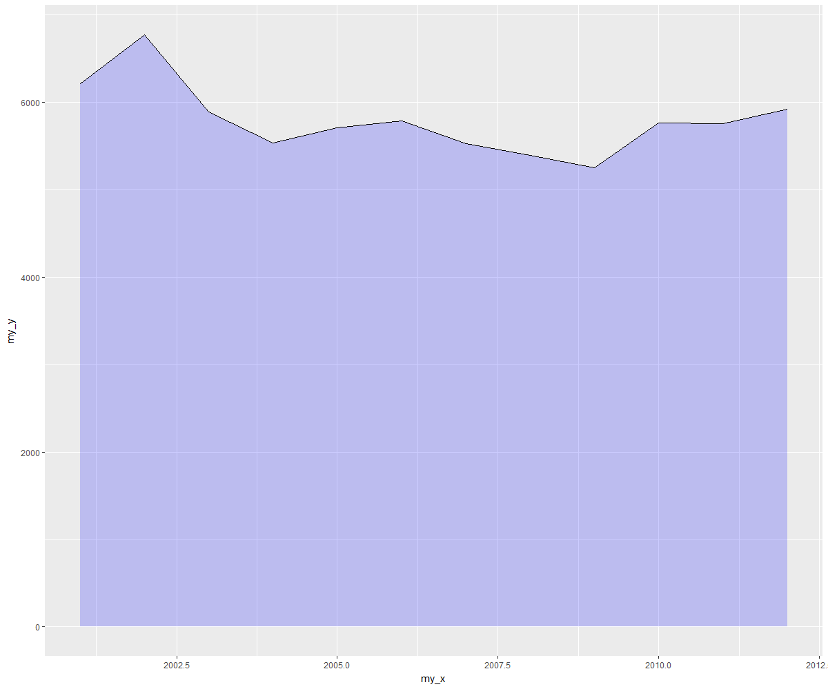
Crimes committed against ST Year By Year

Slide 5
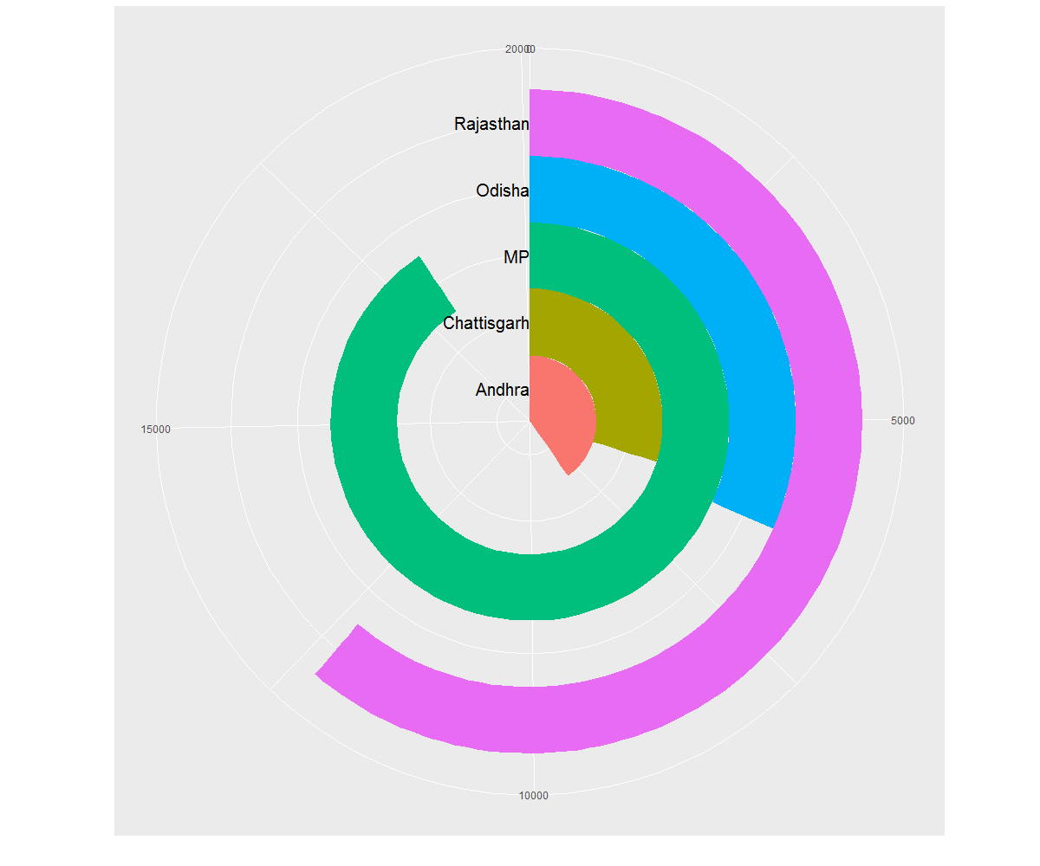
TOP States in which crimes against ST are happening

Slide 6
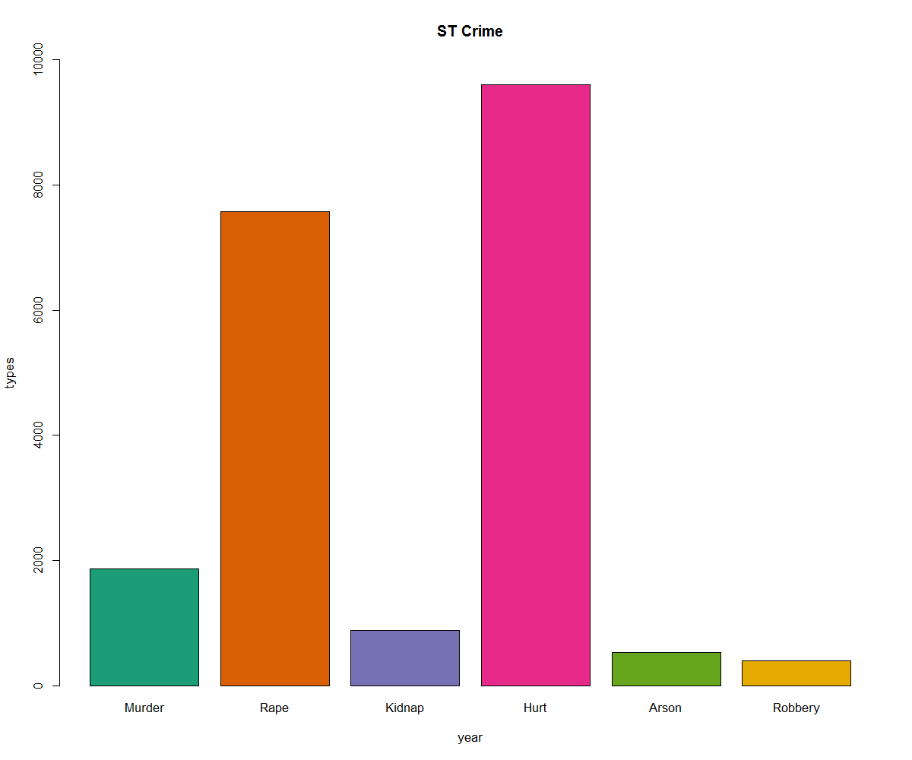
TOP Types of Crimes against ST

Slide 7
Observations
MP and Rajasthan are the places where Crimes against ST population is the highest.
The rate of a Crimes has been moderate and a bit less compared to the past which is a good sign.
Hurt of ST and also Rape have been the major types of crimes being committed.
The highest population density of ST lies in North East India but the crime rate there is very less (5.7%) compared to the Deccan and Thar regions of INDIA.

Slide 8
Objective – 2 Crimes committed against Woman
Goals :
Year by Year Number of Crimes committed against Woman
Rape Crime analysis against Woman
Top Crimes committed against Woman

Slide 9
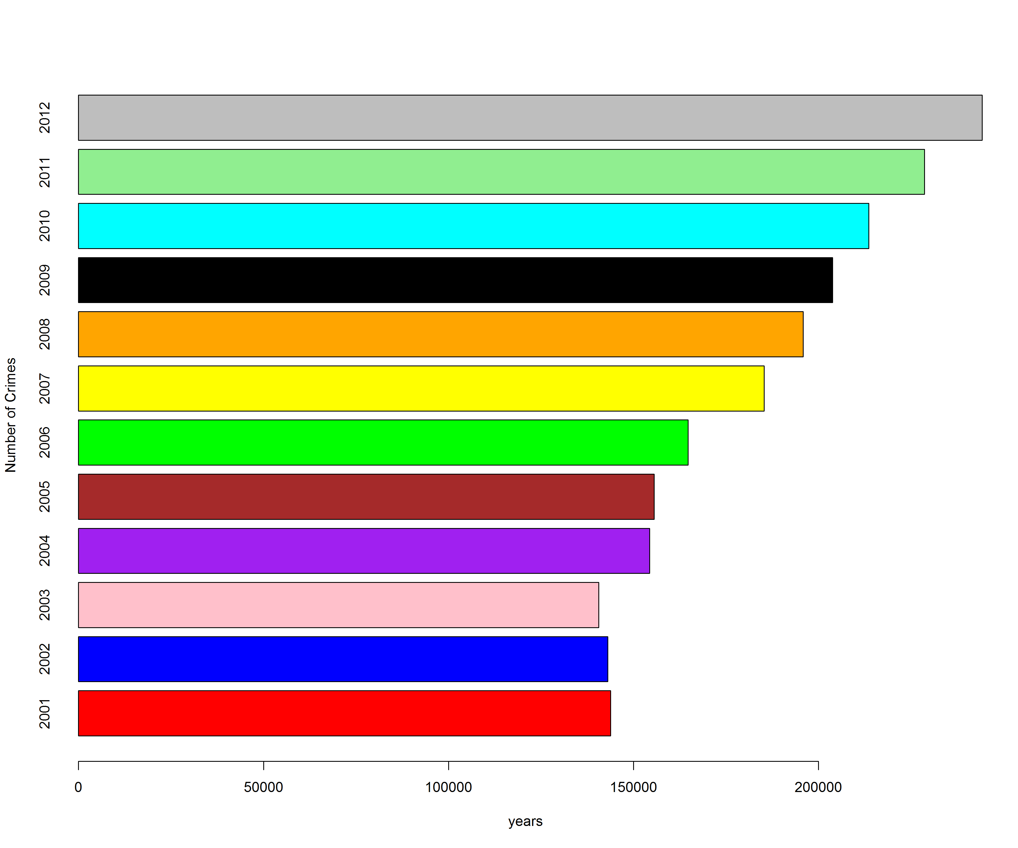
Year by Year Crimes against Woman

Slide 10
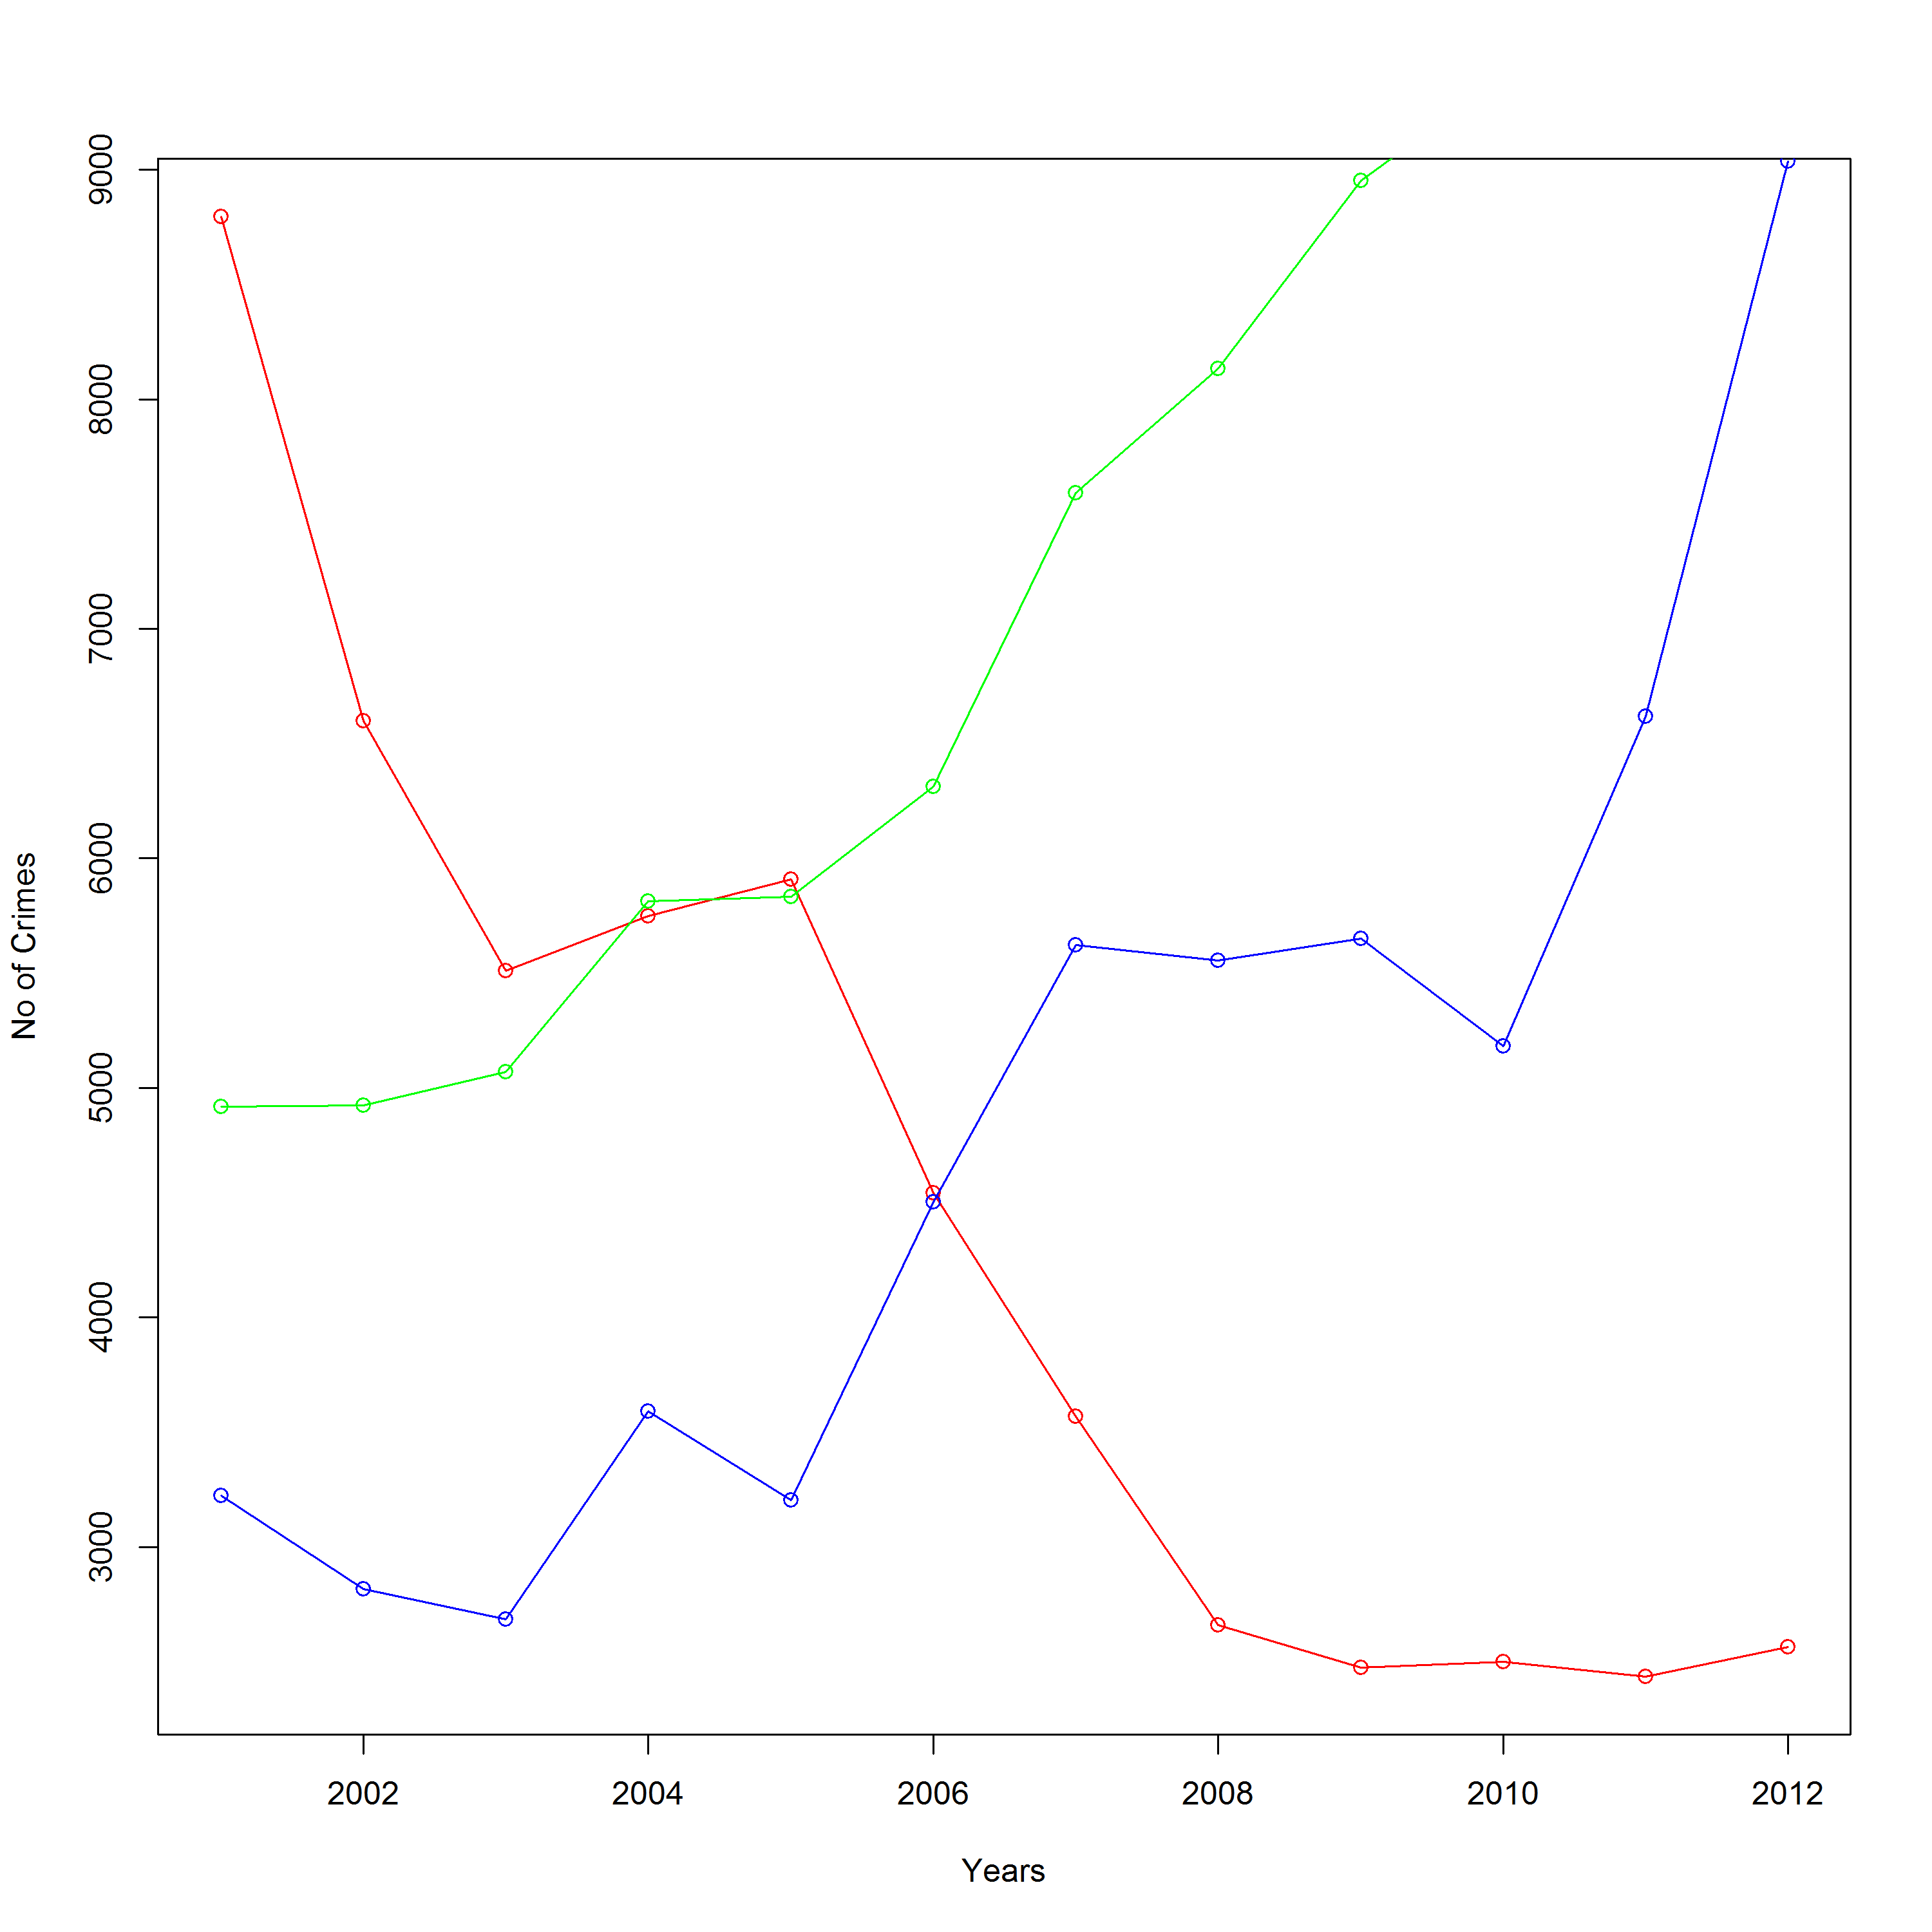
Types of Crimes analysis
Green – Husband
Red – Assault
Blue - Dowry

Slide 11
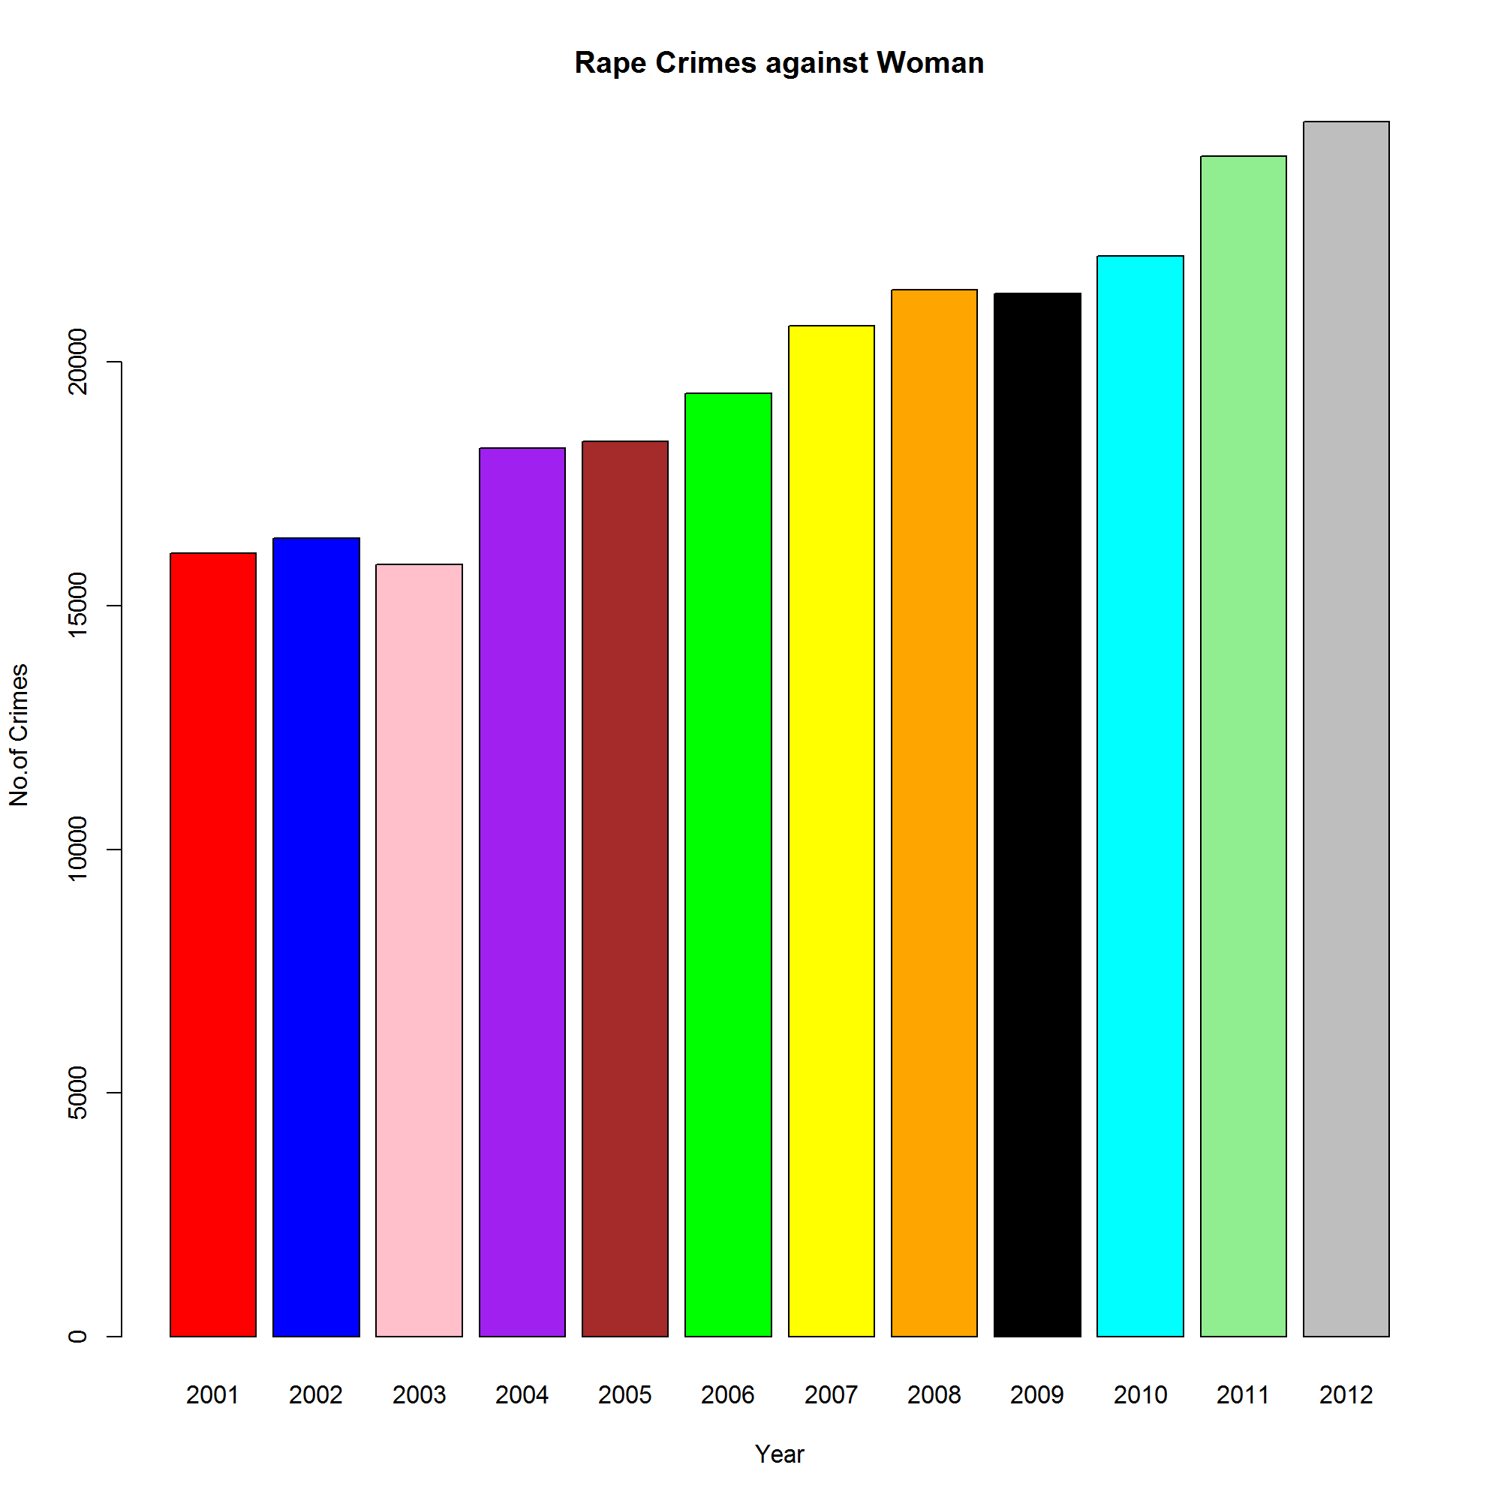
Rape Analysis against woman

Slide 12
Observations
We can observe the rate of increase in Rape Cases in India is not so high it is negligible when compared to the rate of Increase in Population
Assaults against woman for Immorality has come down rapidly and this is a good sign showing modernization.
The total number of Crimes are being increased against woman and the main type of Crime Increasing the cause is “ Violence by Husband”
Domestic Violence is the most filed case by women which has a taken a huge leap.

Slide 13
Objective -3 Juvenile Crimes Committed
These are crimes committed by Citizens below the age of 18
Goals :
Crimes committed in this Section
Total Crime analysis as per data year wise

Slide 14
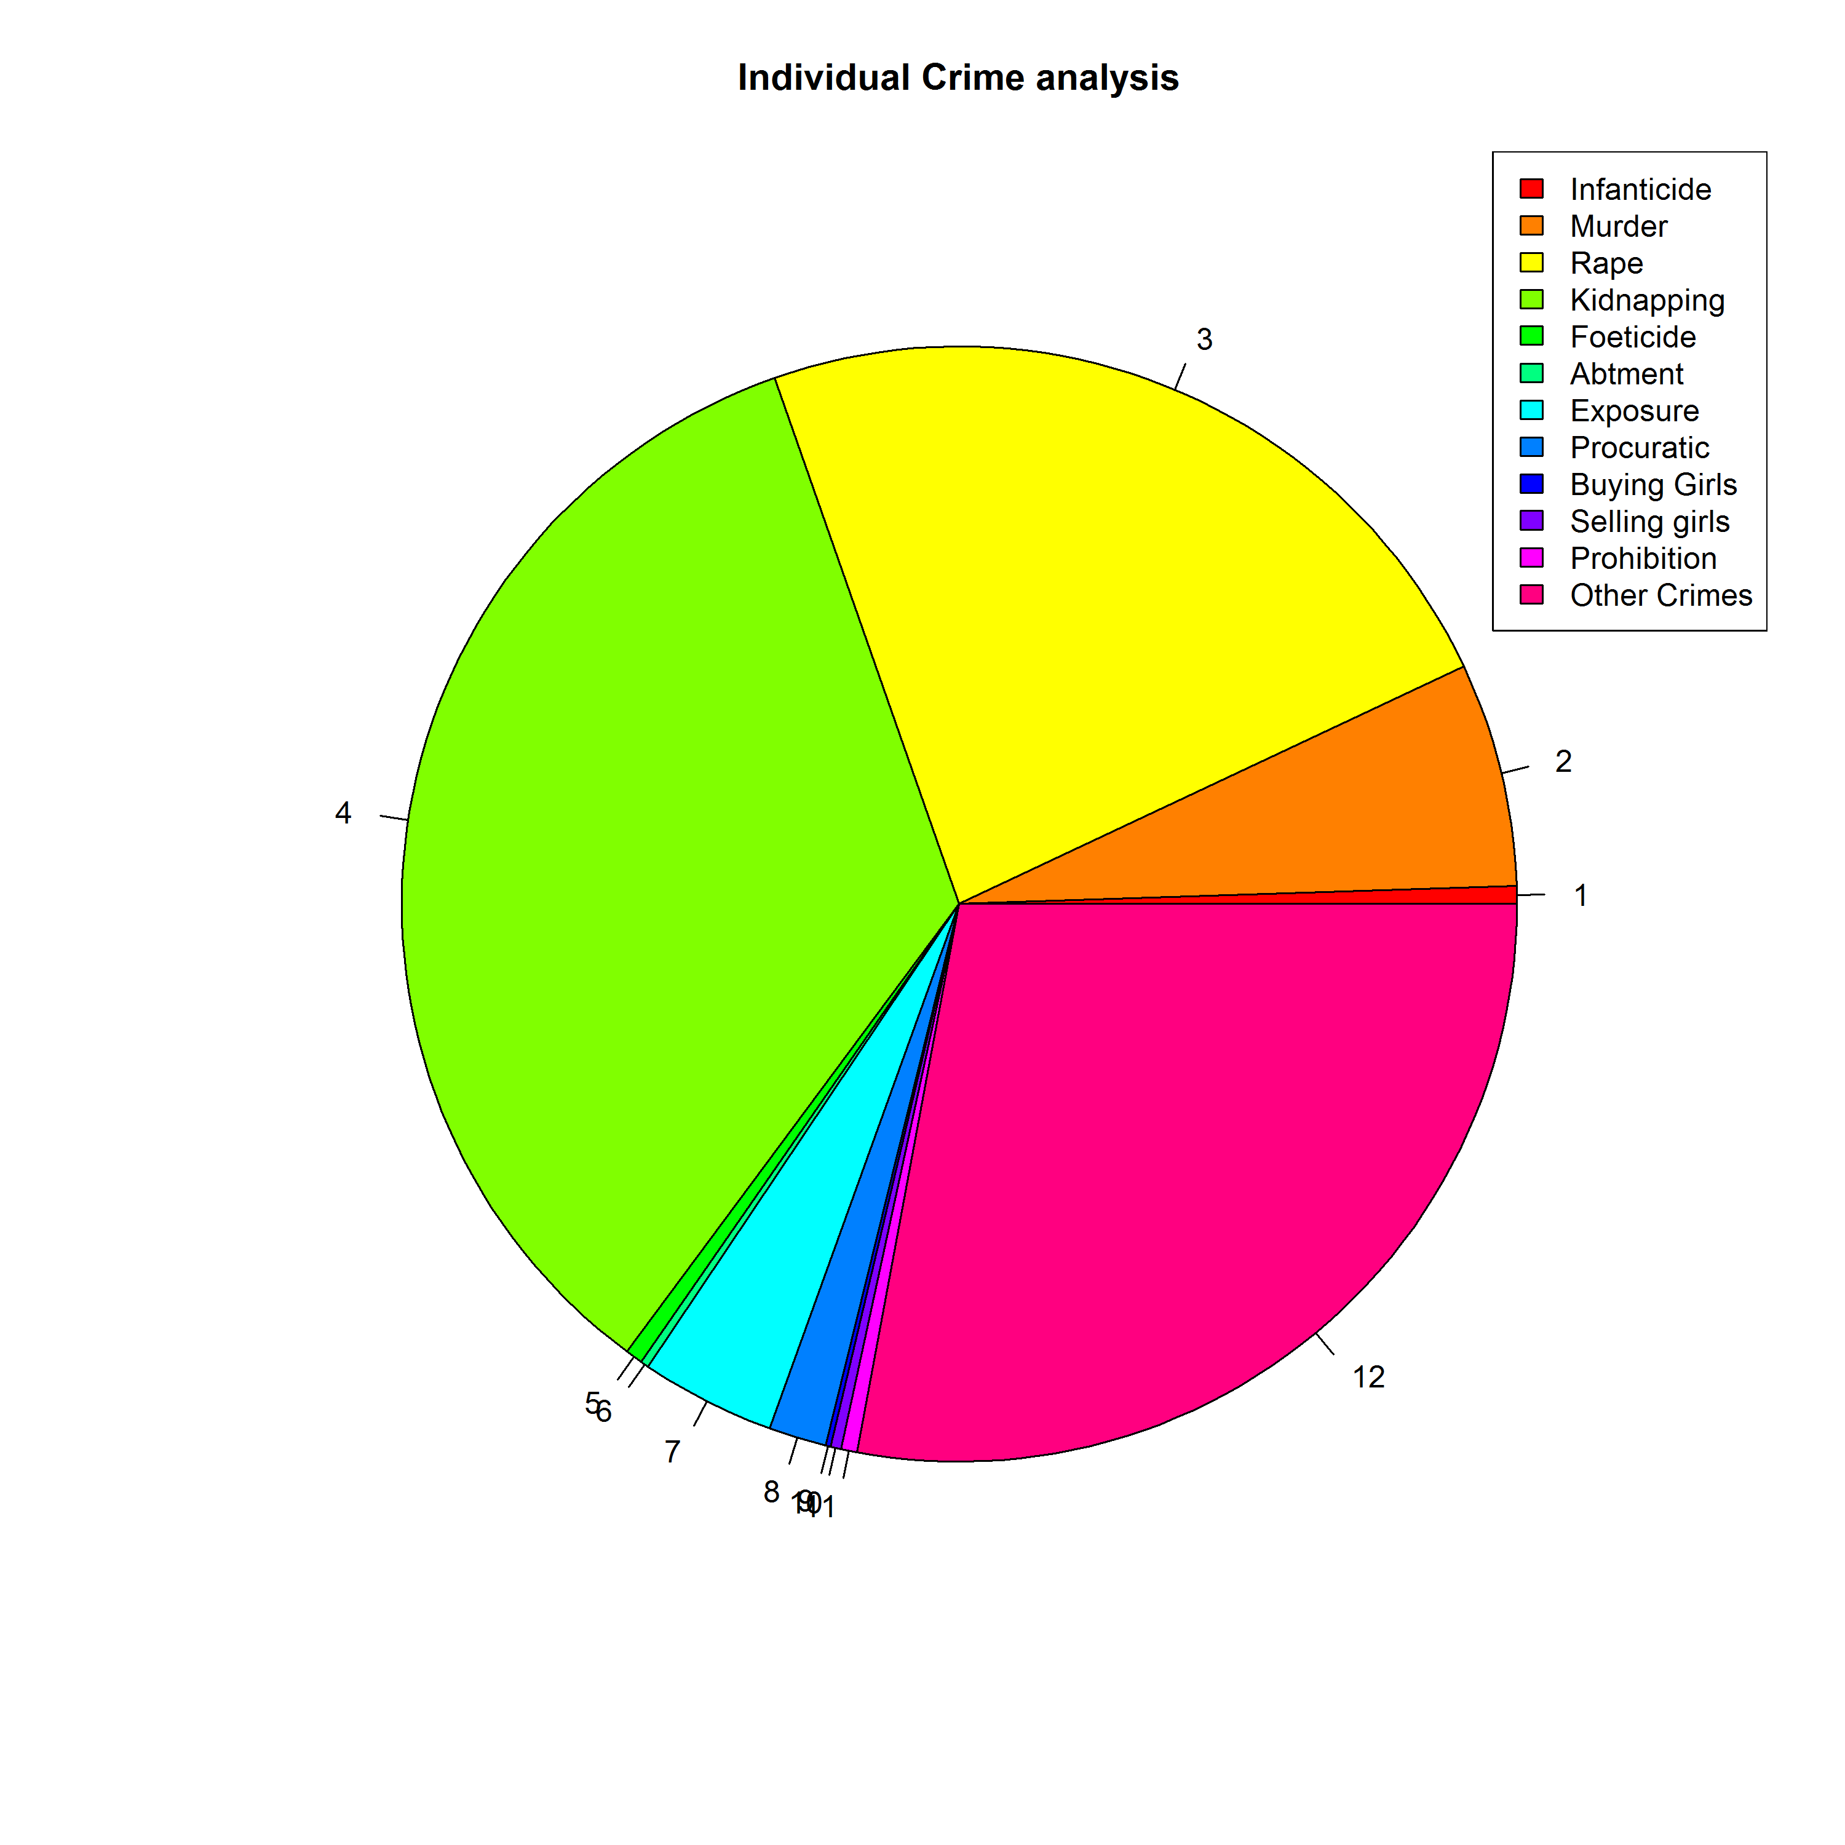
Type of Crimes analysis Juvenile Data

Slide 15
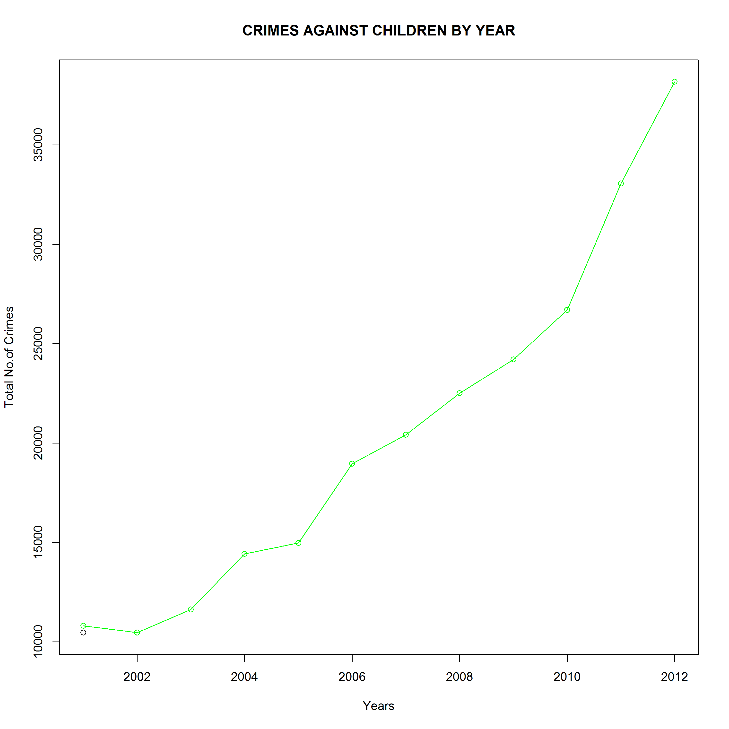
Year Wise Analysis of the Juvenile Crimes

Slide 16
Observations :
The rate of which the Juvenile Crimes are increasing is very high and is an alarming one to be taken care of
Rape and Foeticide are major crimes Juveniles committing showing the Girl Child discrimination in India.
Prohibition of Children is also a Crime which is still persisting in the society.

Slide 17
Objective – 4 Crimes Committed against Scheduled Castes
Goals :
Top Crimes committed against Scheduled Caste people.
Top States where Crimes against Scheduled Castes are being committed.
The Rate Analysis of Crimes committed over the years recently.

Slide 18
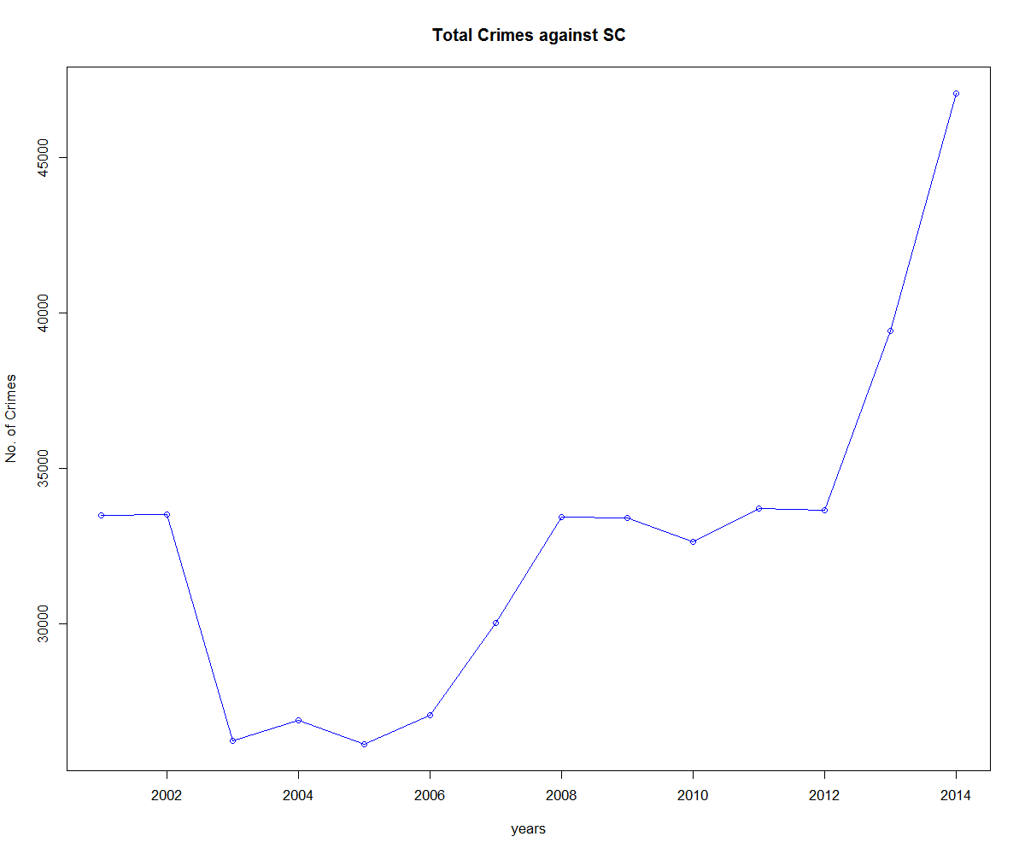
Rate Analysis of crimes against SC

Slide 19
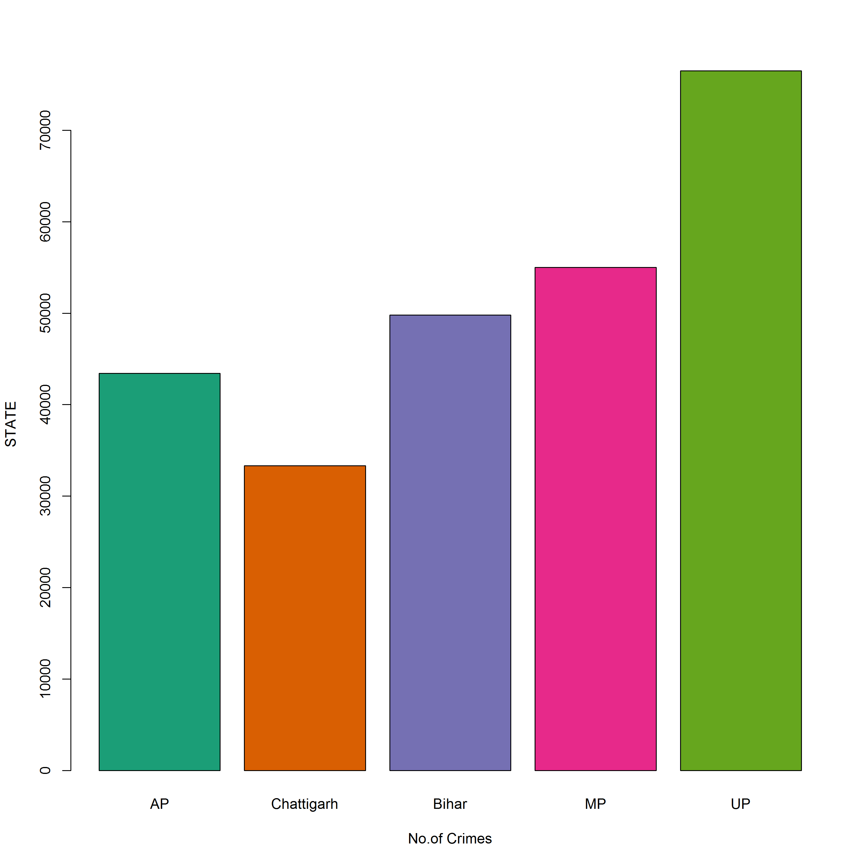
Top States - Crimes are against SC

Slide 20
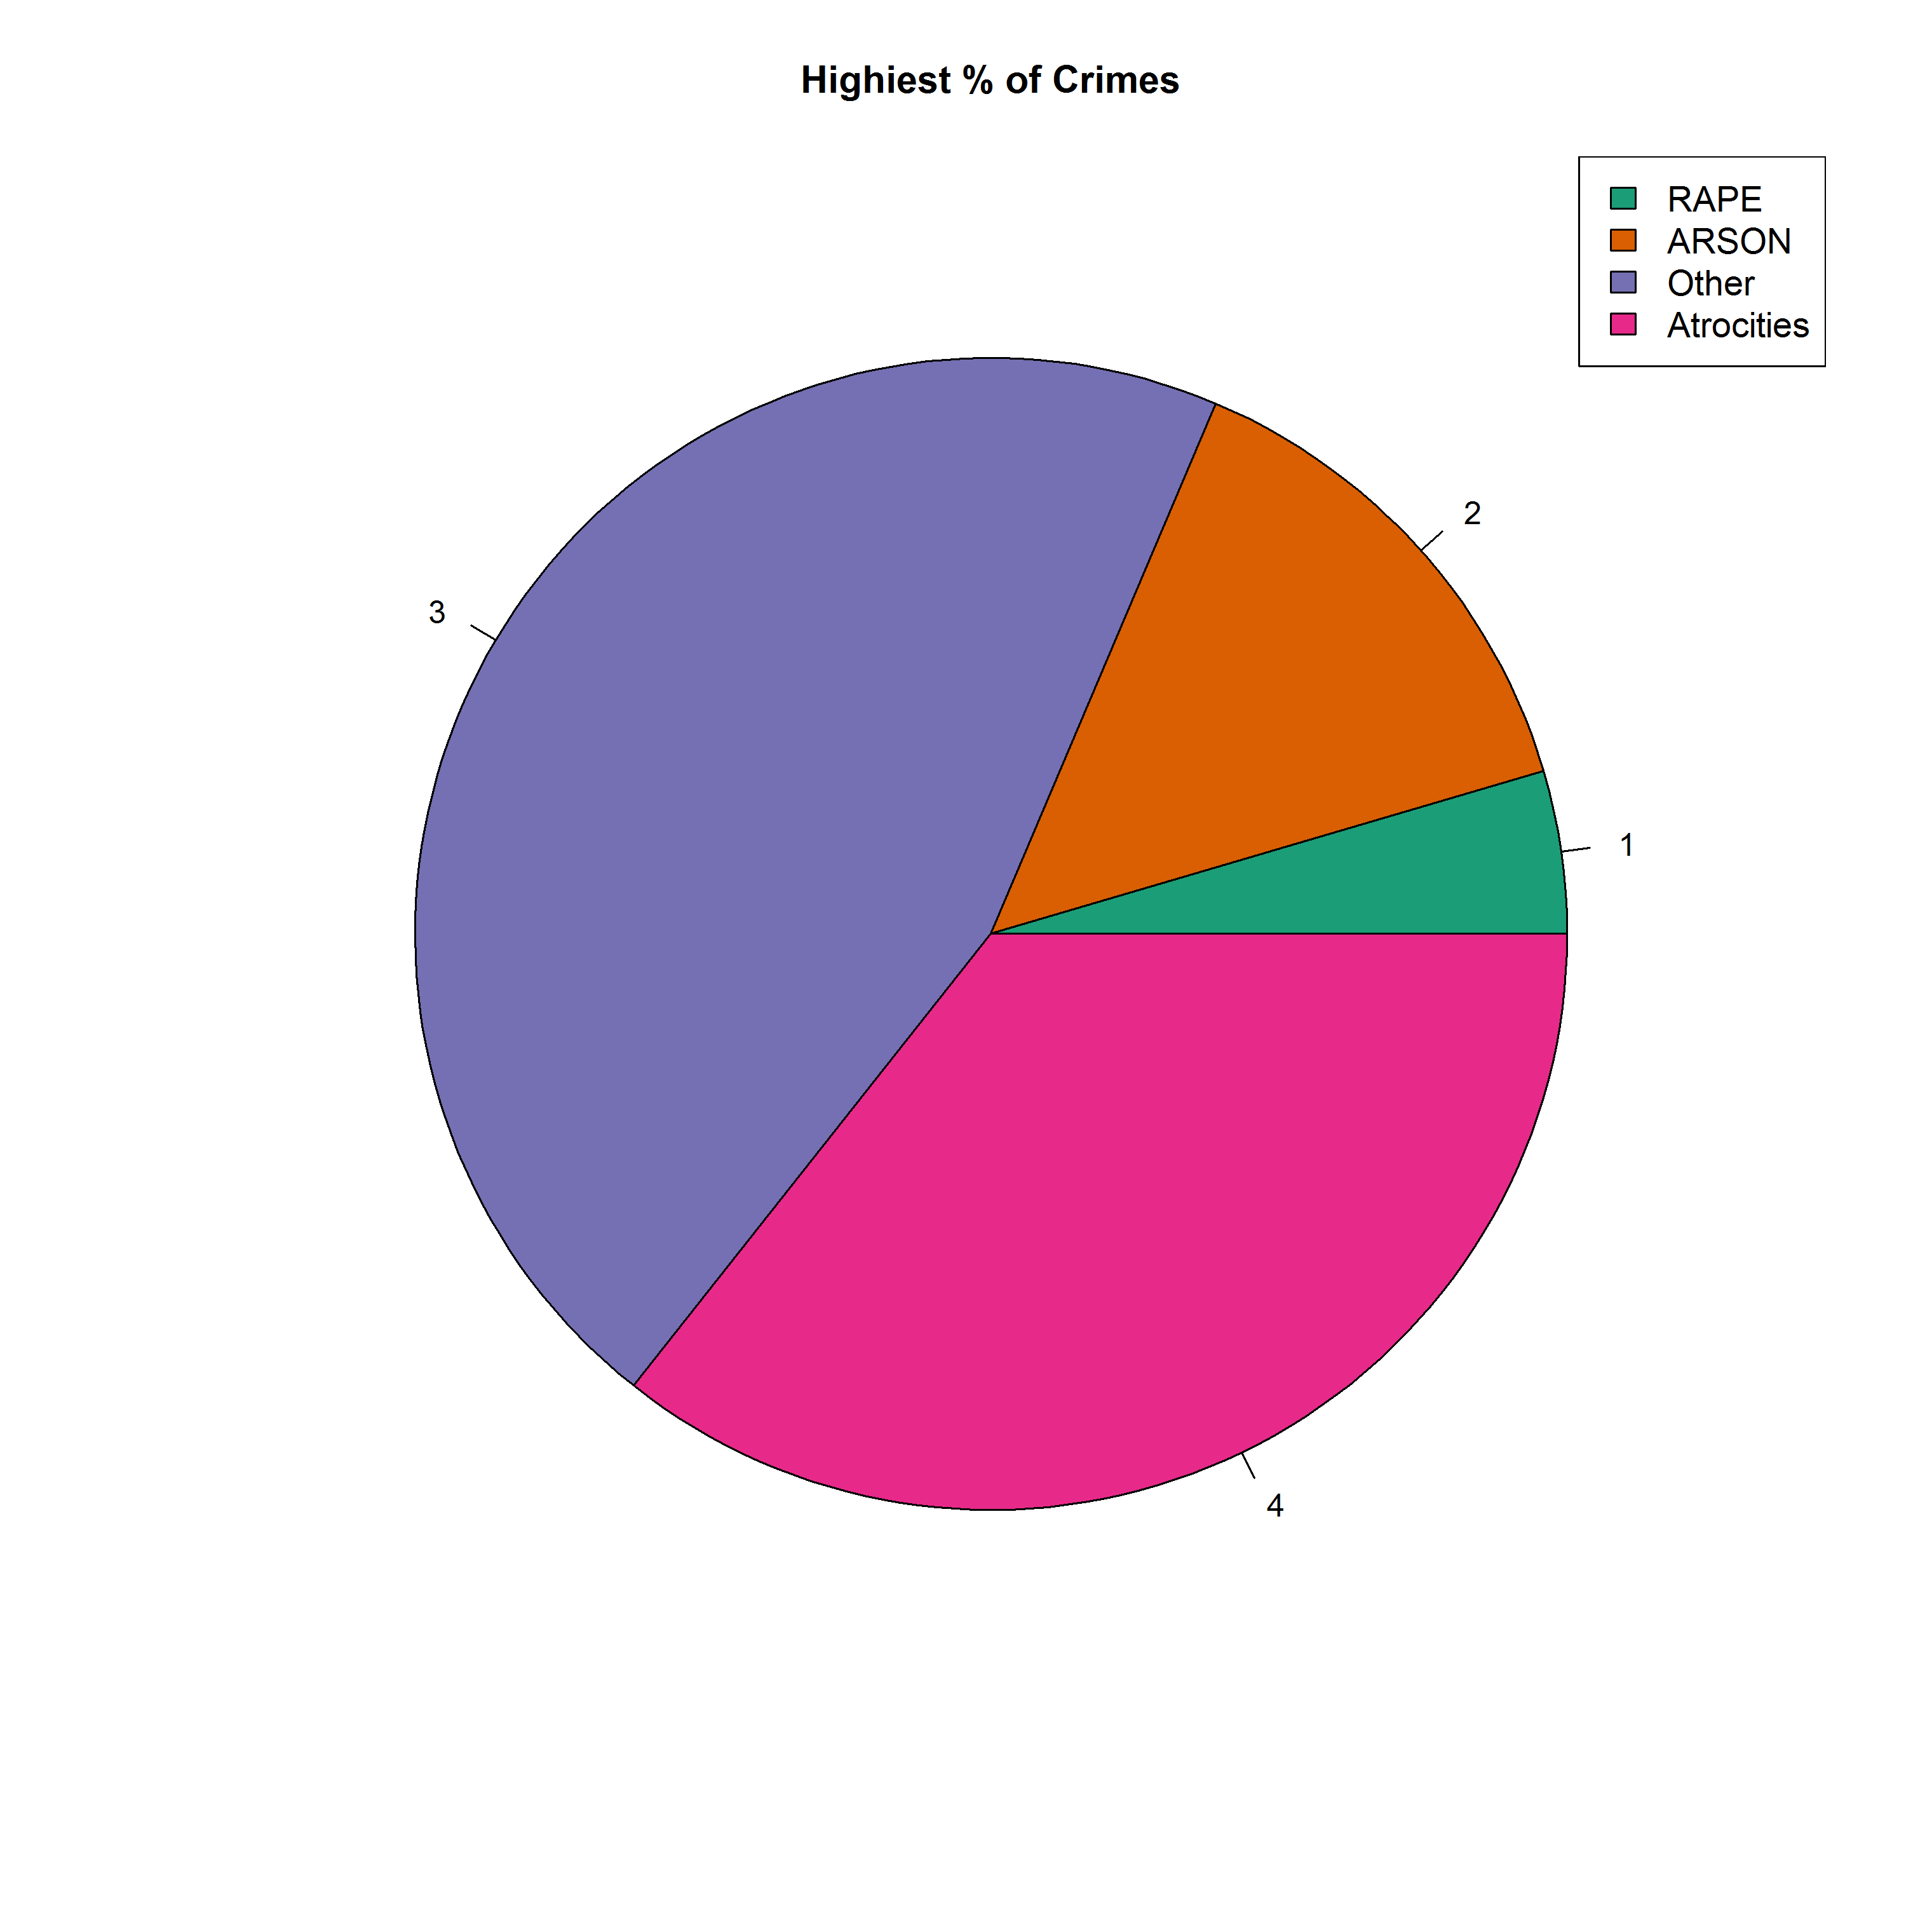
Top Crimes committed against SC

Slide 21
Observations :
Arson and Atrocities are the major crimes committed against SC people in India showing Racism.
MP and UP together constitute to the 40% of Crimes against SC in India.
There was huge fall in Rate of Crimes against SC in UP that was when BJP was the ruling party, but later there is a surge when the ruling party is SP

Slide 22
Objective – 5 Crimes against Children in India
Goals :
Top Crimes committed against Children.
Rate of Increase in Crimes against Children in India.
The Rate of Top Crimes showing a Factor of Rise in Kidnaps.

Slide 23
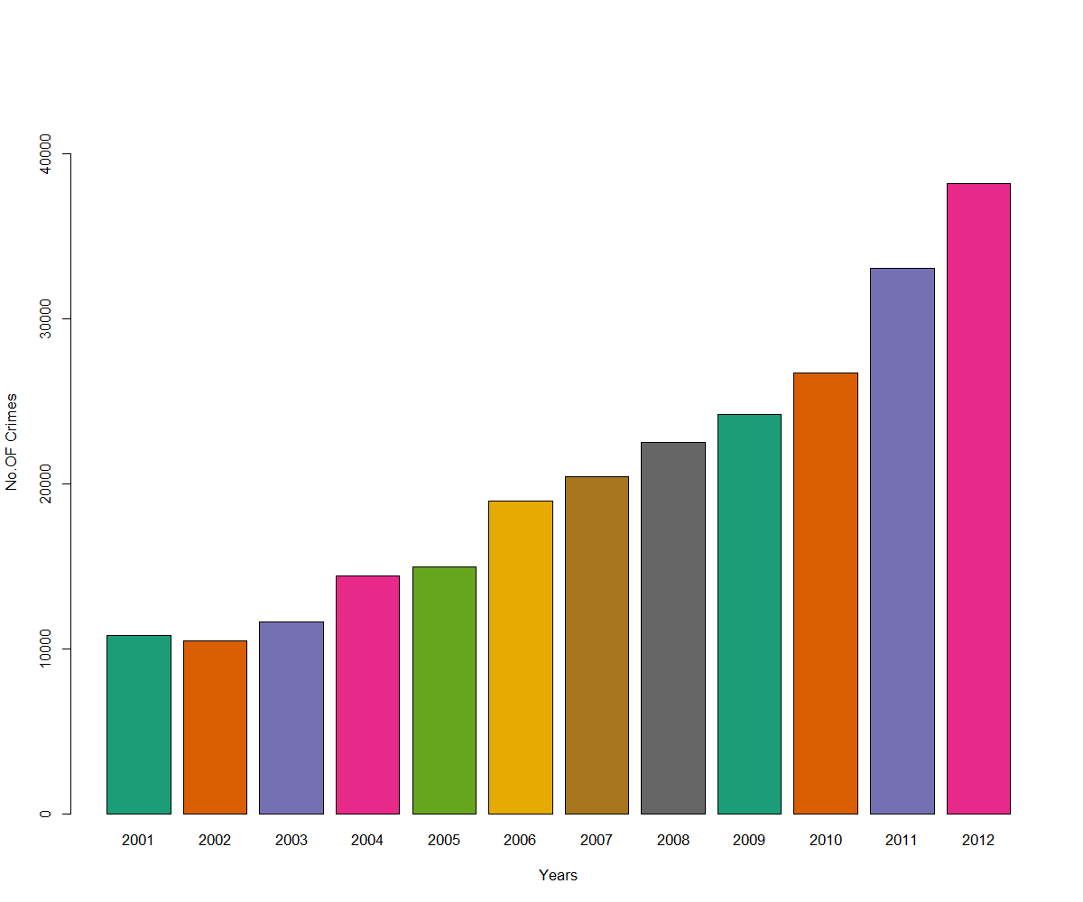
Rate of Increase in Crimes against Children

Slide 24
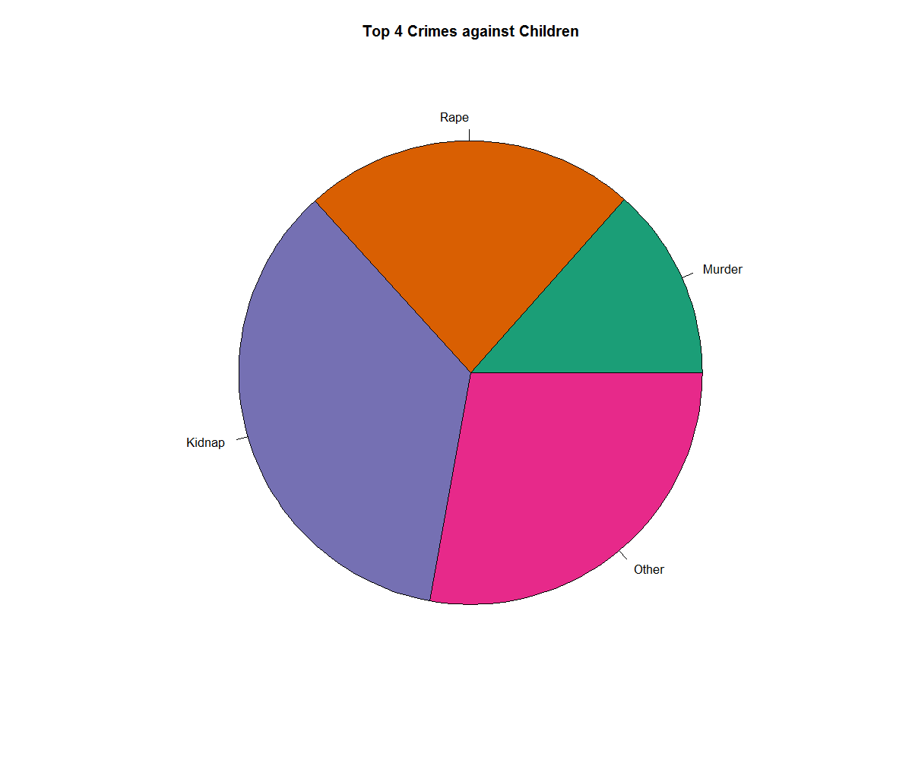
Top Crimes Committed against Children

Slide 25
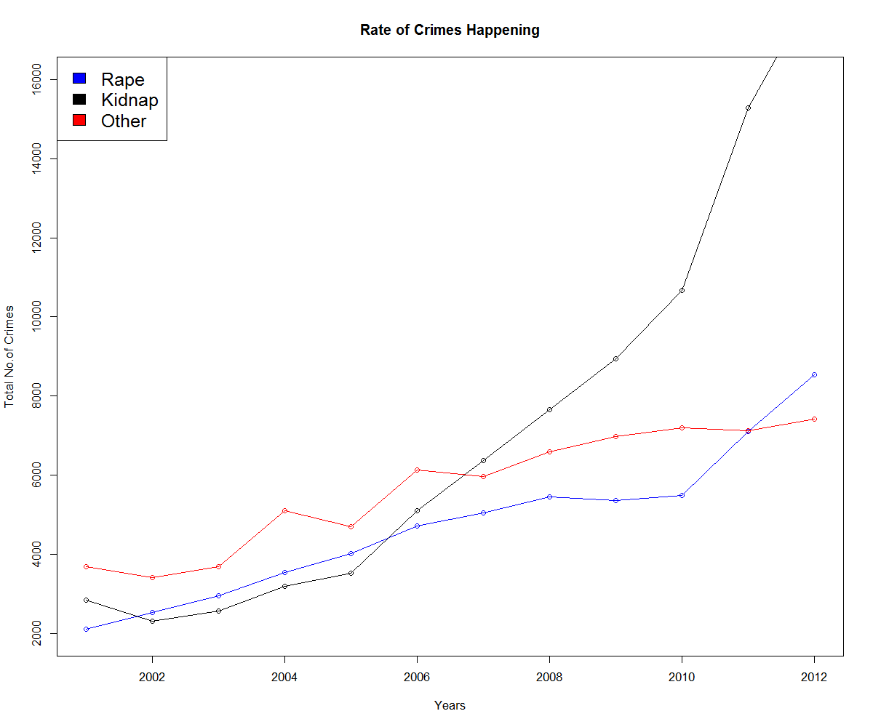
Rate of Increase in TOP Crimes against Children

Slide 26
Observations :
Rape, Murder, Kidnap are the highest fraction of Crimes which are being committed against children.
The rate at which Kidnaps are growing in Children is a notable thing. On further observation the top states where kidnap is high are Maharashtra and West Bengal. Showing the effects of Mumbai and Kolkata.
Children are very safe in North East part of India where the crime rate against Children is as less as 12%.

Slide 27
Conclusions :
We can conclude from all the data gathered that Andaman & Nicobar Islands is the safest place in India with the least crime rate.
UP, MP, Bihar are 1st , 2nd , 3rd most dangerous states considering the amount of crimes happening there.
There is a decline in the crime rate in South India since the year 2004 combining the states of AP,TN, Goa, Kerala and Karnataka.
Kerala with 2nd highest Literacy stands 5th from the bottom in number of crimes showing that literacy rate effects the No. of Crimes

Slide 28
It is clear that union territories have the best administration as the crime rates there are very even with respect to the population there.
North East States show there’s a decline in the crime rate, a healthy sign of improvement.
There are more kidnaps and rapes in India after Arson which is the most major crime committed in J&K.

Slide 29
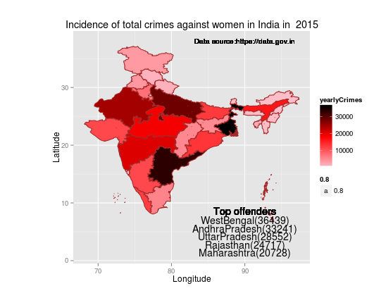

Slide 30
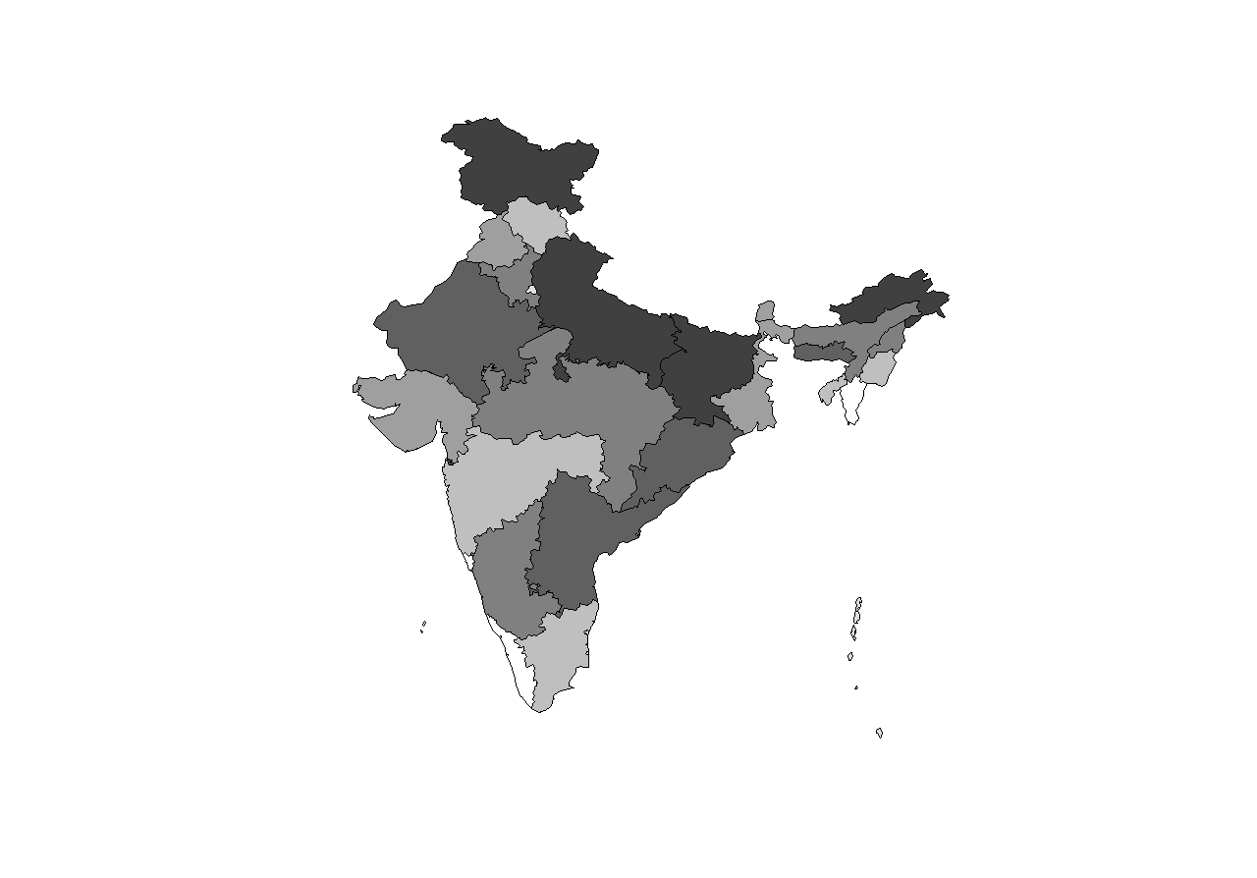
Crime Rate vs Literacy Rate
Crime Rate
Literacy Rate

